Slide 1
Topics Detection using Dowker Complex
American University
Researcher: Jaehee Lee
Advisor: Dr. Robinson

Slide 2
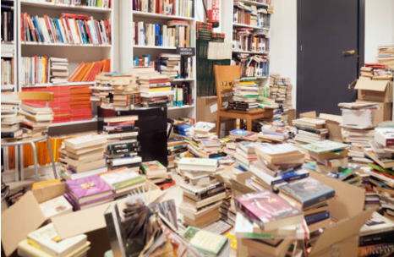
Introduction
Imagine going to a library where all the books are not organized like this…
Notes:
Assumes that different words are independent random variables. There is a methodology that works even independent assumptions, but it does

Slide 3
Research Goal
Librarians traditionally classified books by hand using classification tables.
Dewey Decimal Classification (DDC) Library of Congress Classification (LCC)
Research Goal is to use the Dowker Complex method to classify documents into specific topic categories based on relevant/common terms.

Slide 4
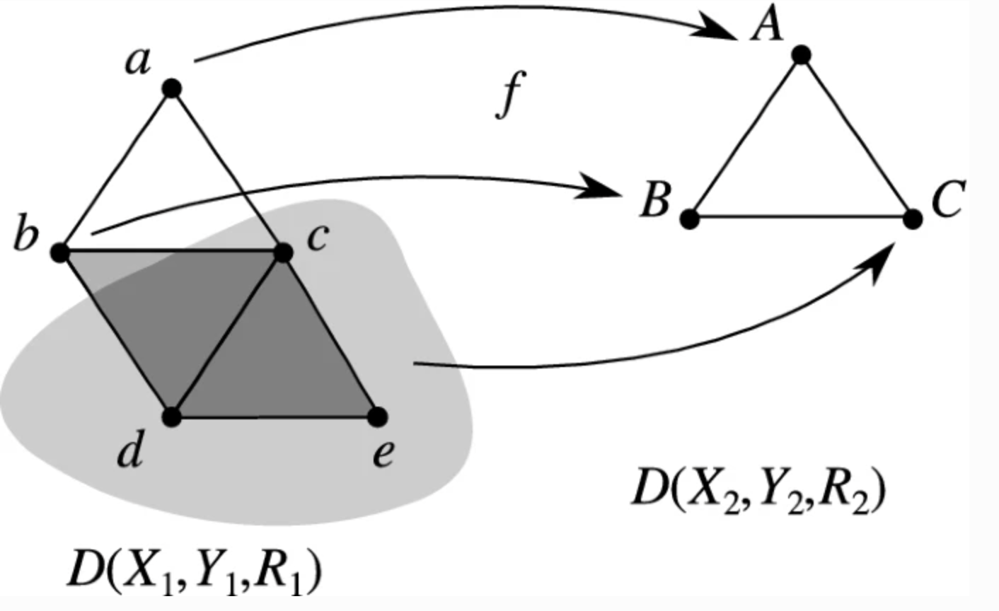
Dowker Complex
In 1951, Dowker introduced
Potentially used in many areas such as Mathematics and Data Science (Ghrist, 2014)
The structure of an abstract simplicial complex
Used the Dowker Complex based on word usage among documents
In a matrix format to represent the relationship between terms and documents
[Cosheaf representations of relations and Dowker complexes, Dr. Robinson, 2022]

Slide 5
Comparison with Standard Methods
TF-IDF | K-Nearest Neighbors | Logistic Regression
TF-IDF computes documents’ similarity only based on individual word count. TF-IDF cannot group documents based on groups of terms. | By identifying the K closest neighbors to a new data point, it can generate forecasts for the the new datapoint. KNN does not work well with textual data | Logistic Regression assumes that between predictors and response variables is linear, but in the complex data this may not always be the case
Dowker Complex: It is classifying documents by sets of relevant terms. Conversely, we can find documents based on terms that occur together. | Dowker Complex: If KNN does detect relevant geometric features then so will the Dowker Complex. This project results show that applying Dowker Complex to textual data is useful. | Dowker Complex: Can analyze complex data including those that may not be linear structure. It can overcome non-linearities in the data

Slide 6
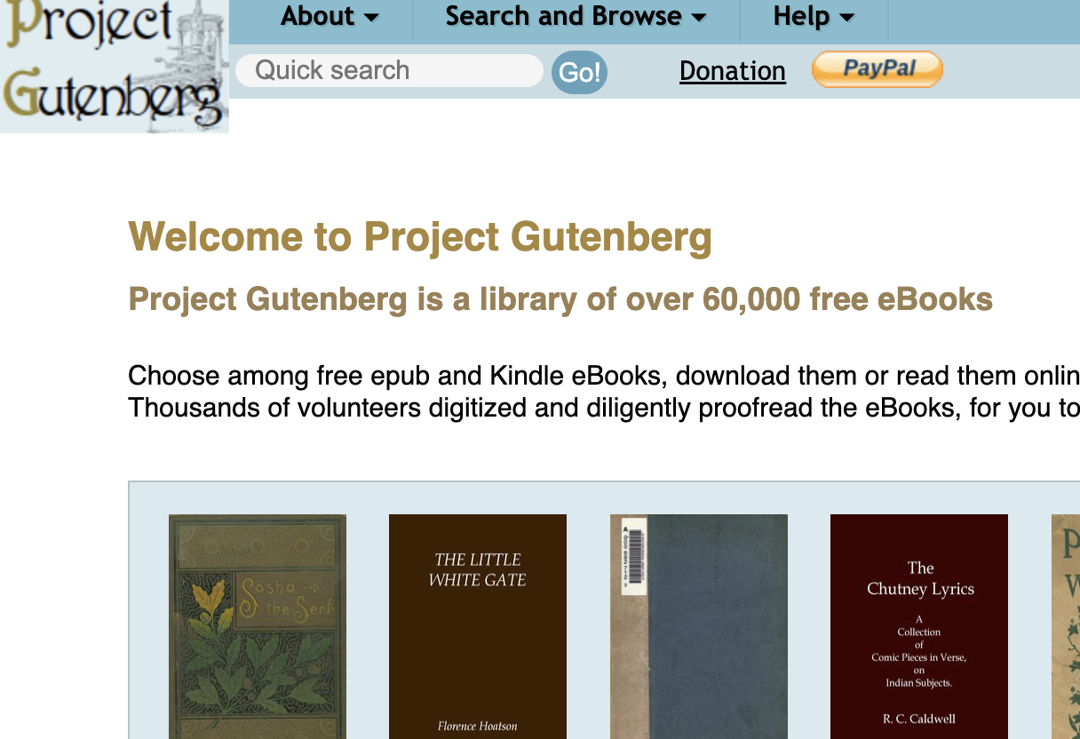
Data
Data: Gutenbergr library in R
Sample Size: 100 books
Sampling Method: Stratified random sample
Topics: Politics, Art, Biology, Cookery, Travel

Slide 7
Procedures
01
Download Data
04
Apply TDM
02
Convert
05
Identify
03
Clean Corpus
06
Dowker Complex
Download 100 books from Gutenberg library
Apply Term Document Matrix (TDM)
Convert text to a corpus
Identify Non-zero values
Remove stop words, numbers, etc.
Apply the Dowker Complex
Notes:
Note: you can add between 3 and 6 sections, the structure can vary. The numbers have to be kept , Data cleaning is important, stop words removal, stop words removal using tf-idf

Slide 8
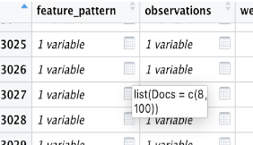
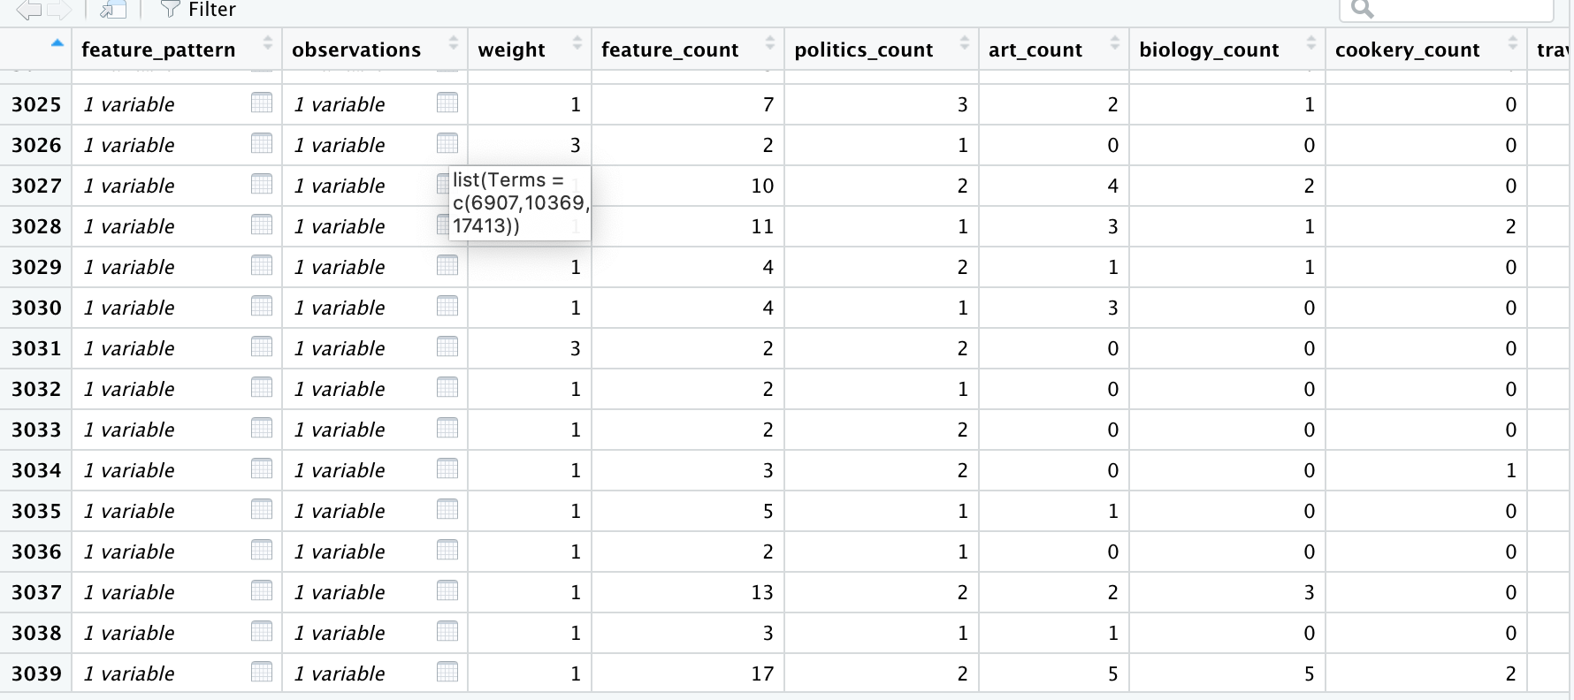
Output of Dowker Complex
Notes:
Expanding

Slide 9
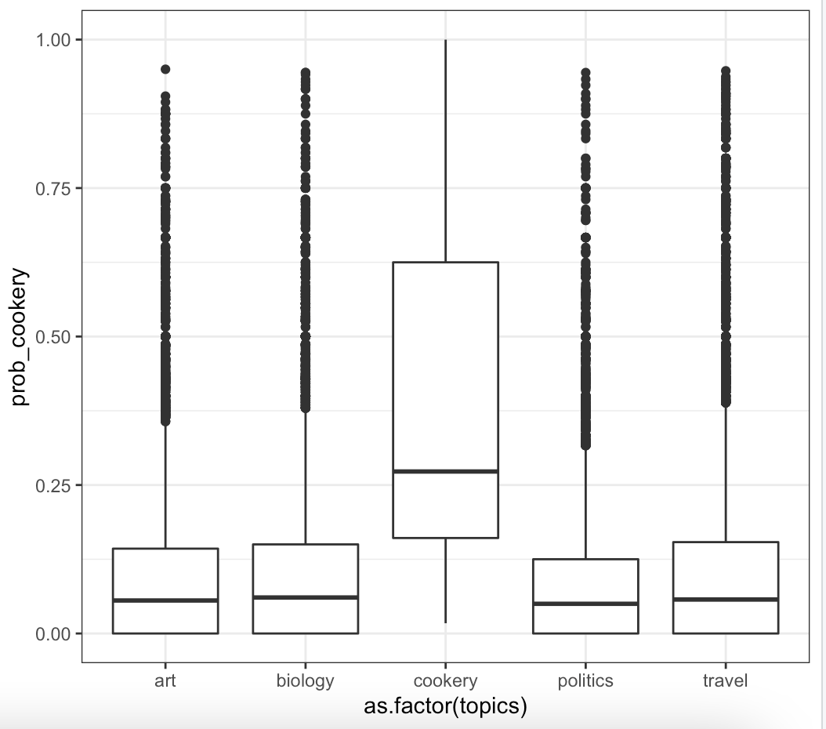
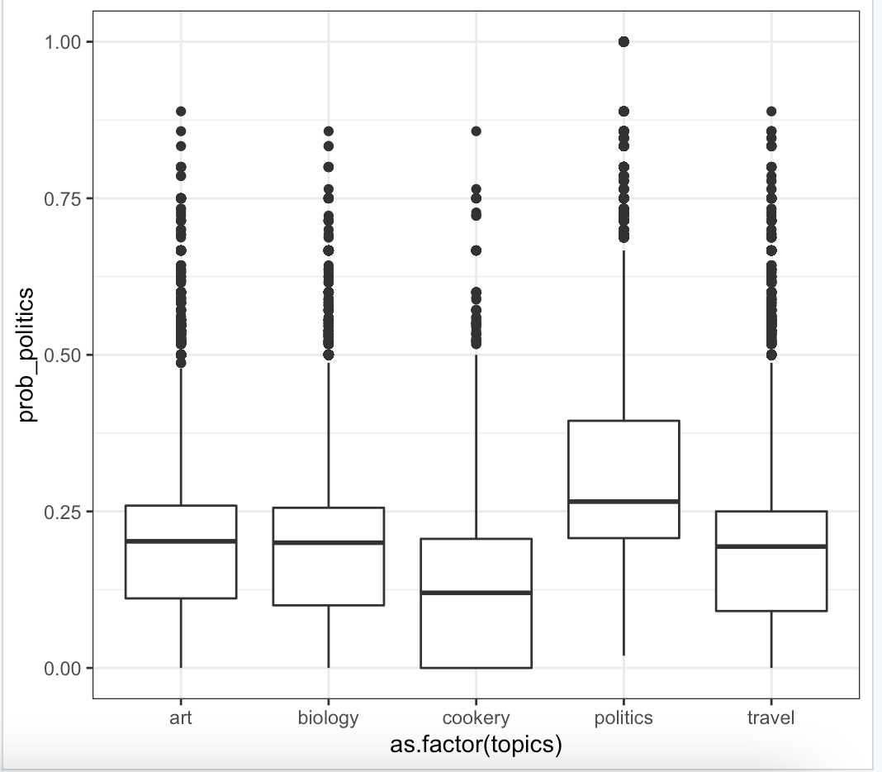
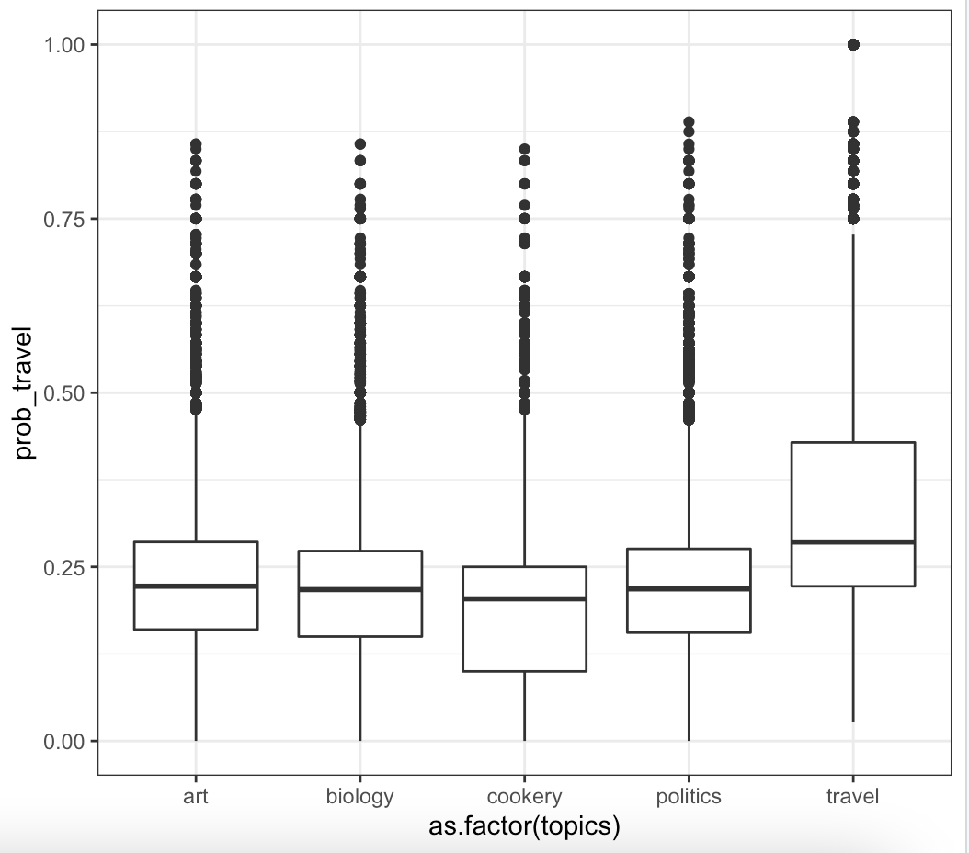
Results
The Dowker Complex separates the documents by their topics,
as measured by the topic's probability

Slide 10

Conclusion
Search Engine
Researchers
Librarians
Notes:
Dowker Complex -> Search Engines -> Same technique is used right now as part of file behavior based search engine that Dr.Robinson working on. Some of his same code is being used in that project.

Slide 11
References
Photos:
https://www.istockphoto.com/photos/messy-library-book-stack
Presentation format using Slide go
Research Paper:
Robinson, M. Cosheaf Representations of Relations and Dowker Complexes.

Slide 12
Thank you

